Slide 1


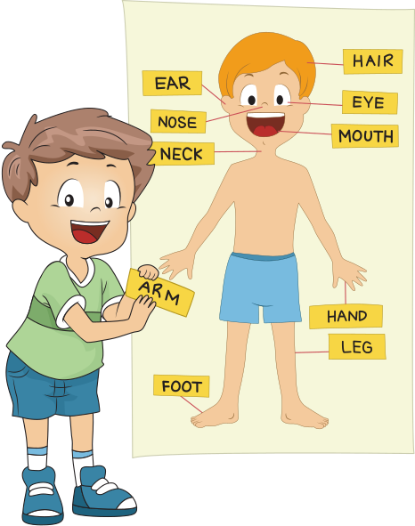


LEARN ABOUT BODY PARTS
By : Science Genius

Slide 2
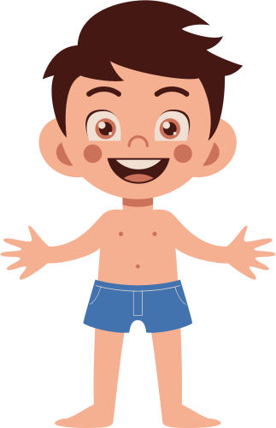

PARTS OF THE BODY
Hair
Head
Chest
Arm
Stomach
Foot

Slide 3

HEAD
Eyebrow
To help hold sweat does not enter the eyeball.
Eye
To see.
Ear
To hear.
Nose
To smell.
Mouth
To talk and chew.

Slide 4

MOUTH
Lips
To keep food not scattered and to smile.
Tooth
To bite and cut food in the mouth.
Tongue
To keep food not scattered and to smile.

Slide 5
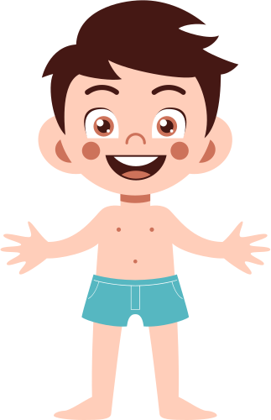
BODY
Neck
Elbow
Shoulder
Hand
Chest
Finger
Waist
Stomach

Slide 6

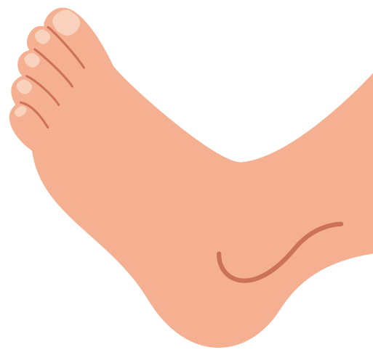
ARMS AND LEGS
Legs
For walk and run.
Arms
For holding something.

Slide 7
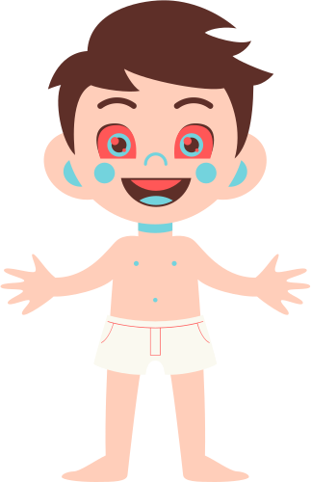
LEGS
Knee
Thigh
Ankle
Toe
Foot
Heel

Slide 8



EXTRA KNOWLEGDE FOR CHILDRENS

Slide 9
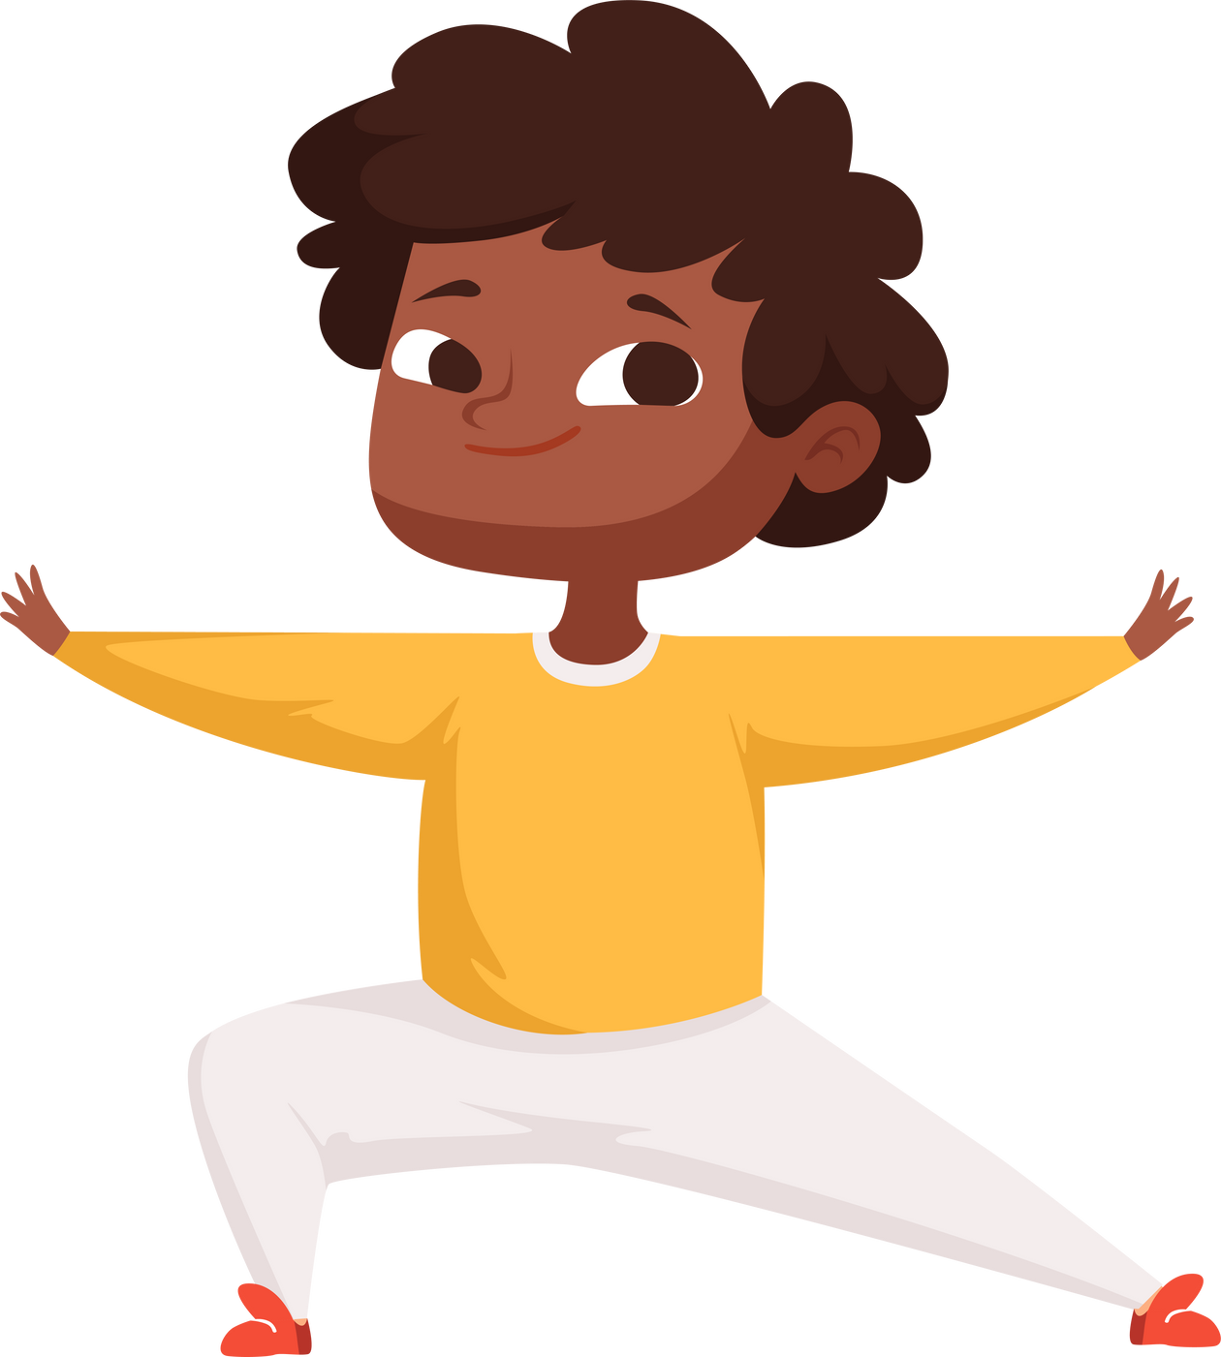
HOW DO YOU KEEP YOUR BODY HEALTHY FROM DISEASE?
Shower regularly, 2x a day.
Shampoo hair with shampoo.
Brush your teeth regularly using toothpaste.
I was reading in a bright place and at a distance of 30cm.
I am trimming nails regularly (cleaning nails).

Slide 10
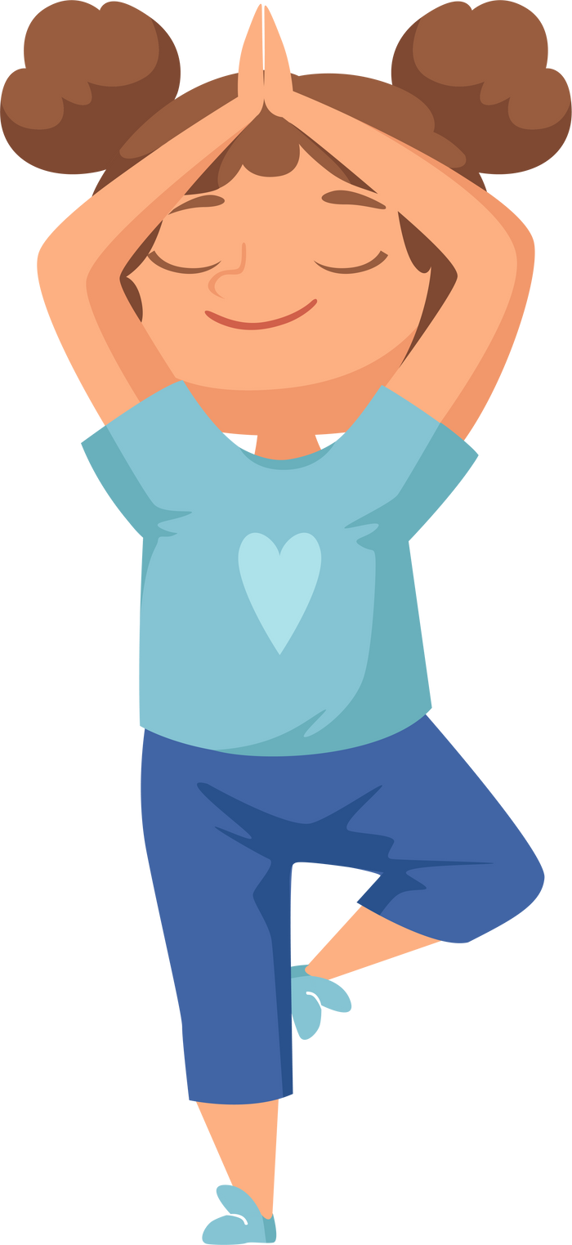
HOW DO YOU KEEP YOUR BODY HEALTHY FROM DISEASE?
Clean the ears with cotton regularly.
Wash hands before and after eating.
Wash your feet when you enter the house.
Cover your nose if you smell bad.
Don't overeat candy.

Slide 11



HAVE ANY QUESTIONS?

